Slide 1
Understanding Career Aspirations of Gen Z
KultureHire Data Analytics Internship
Zainab Shaikh

Slide 2
Project Overview
Project Objective: This project aims to analyze Gen Z's career aspirations, expectations, and workplace preferences to help companies understand and adapt to their evolving workforce needs. The study focuses on salary expectations, career longevity, work environment preferences, manager expectations, and influencing factors behind career choices.
Problem Statement: Many organizations struggle to attract and retain Gen Z talent due to misaligned company missions, unclear career progression, salary dissatisfaction, and workplace flexibility concerns. This project provides data-driven insights to bridge this gap and help companies tailor their policies to Gen Z expectations.

Slide 3
Roadmap
Data Collection and Cleaning
Excel Dashboard Creation
SQL Data Analysis
✅Gathered raw survey data
✅Removed inconsistencies & formatted data
✅Used Pivot Tables for summarization
✅Develop dashboard on career aspiration of GenZ
✅Performed query-based analysis on cleaned data
✅Identified key trends & patterns
Final Analysis & Presentation
PowerBI Dashboard Development
✅Derived key business recommendations
✅Compiled findings into a professional presentation
✅Built interactive visuals & reports
✅Created filters & slicers for deep insights

Slide 4
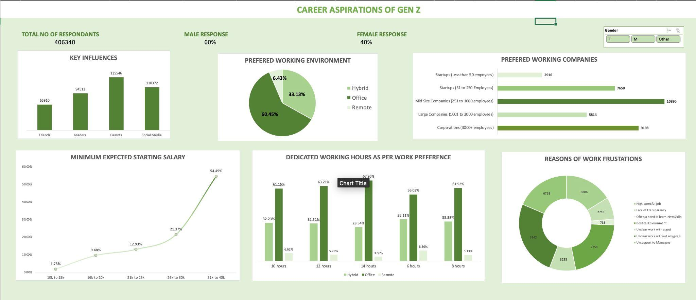
Excel Dashboard

Slide 5
Problem Statement
Changing Mindset of Gen Z
Unlike previous generations, Gen Z is not afraid to break away from family traditions and question toxic behaviors, even if they seem normal to others.
Mental health is no longer a taboo topic, and more people are open to seeking therapy and prioritizing self-care over just working endlessly.
The pandemic disrupted their education and career plans, making them rethink their life choices and focus on doing what truly matters to them.
Social media has exposed them to different career opportunities, showing them that they don’t have to follow the traditional path to success.
The job market is highly unstable, with frequent layoffs and fewer secure opportunities, making it difficult to plan for the future.
Living costs have risen drastically, but salaries have not kept up, forcing many freshers to work for very low pay or even unpaid internships just to gain experience.
Easy access to books, podcasts, and online resources has encouraged them to explore different career paths rather than sticking to just one traditional job.

Slide 6
Problem Statement
Problems Gen Z Faces at Work
Many workplaces still follow outdated rules and rigid work cultures, making it hard for young employees to feel valued or motivated.
There is a huge gap between older employers and Gen Z employees, making it difficult for both sides to understand and communicate with each other effectively.
Gen Z is often seen as disloyal because they change jobs frequently, but in reality, they just don’t want to stay in a place where they feel undervalued or exploited.
Families often struggle to understand their career choices, leading to pressure to follow traditional job paths that may not align with their interests.
Long working hours, low pay, and a lack of work-life balance lead to high levels of stress and burnout, making it difficult to stay in one job for too long.
Final Thought: Gen Z is not lazy or unrealistic; they just want fair treatment, flexibility, and a work environment where they feel respected and valued.

Slide 7
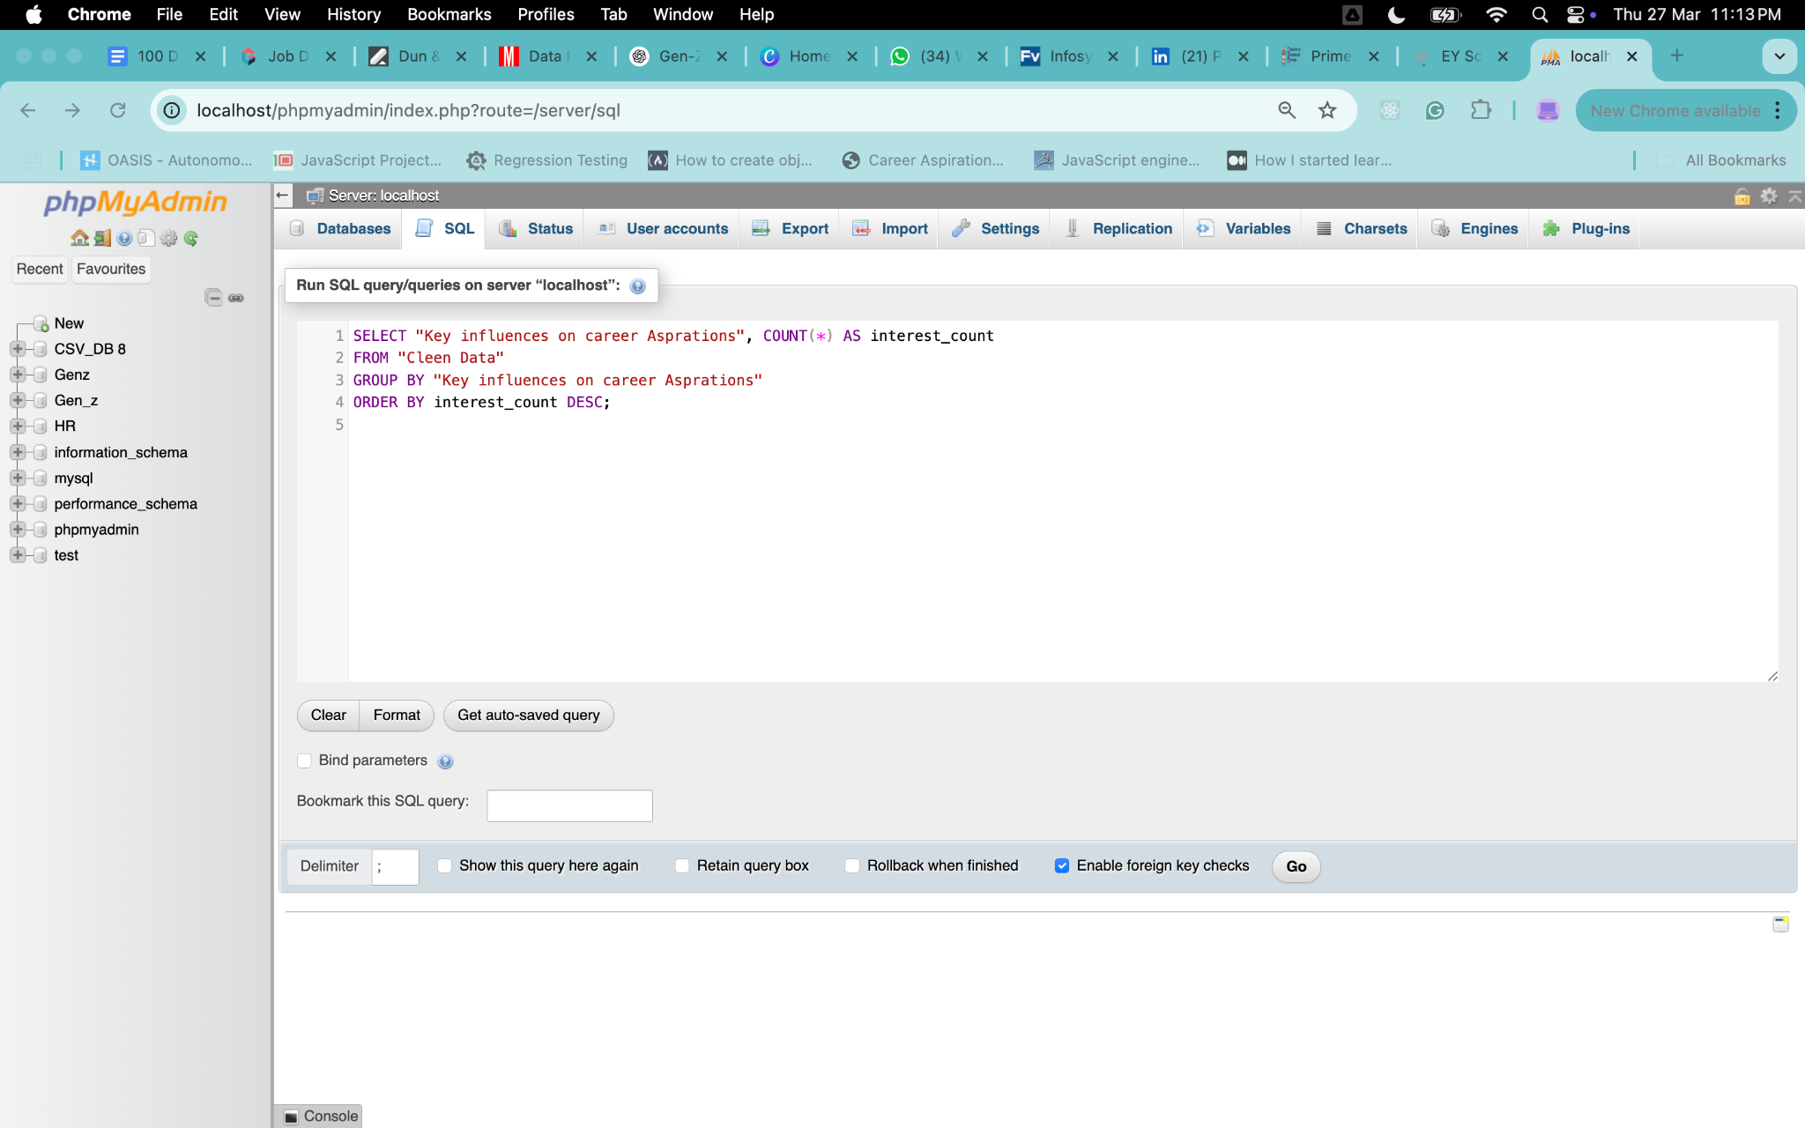
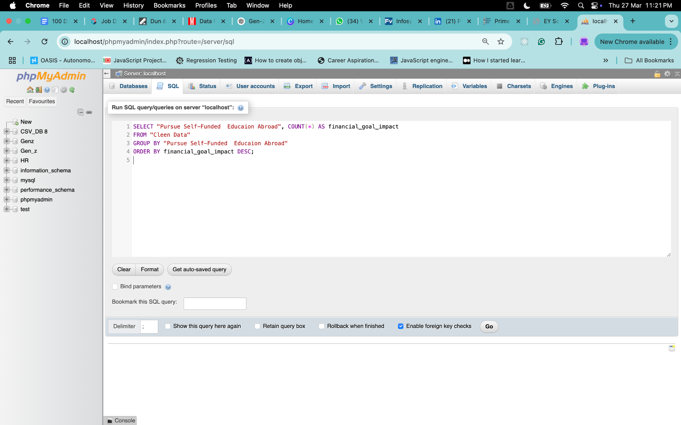
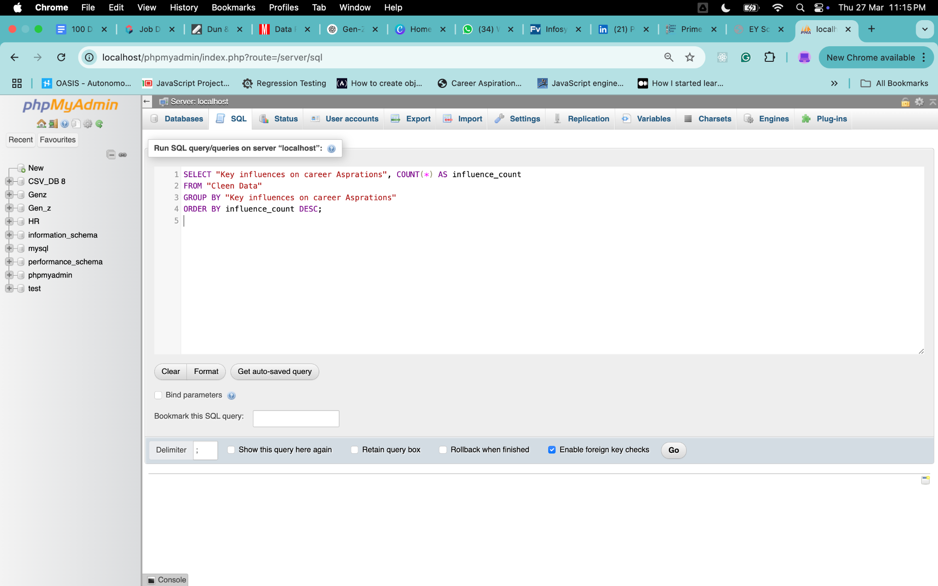
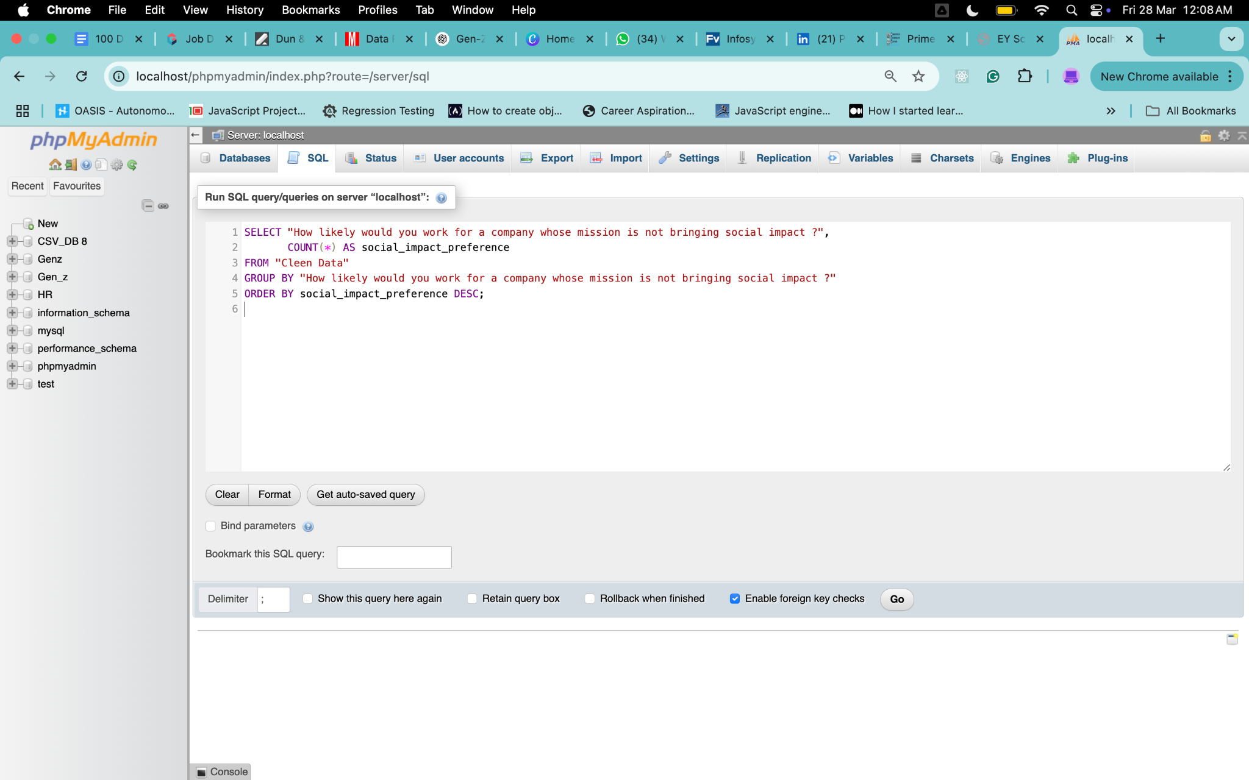
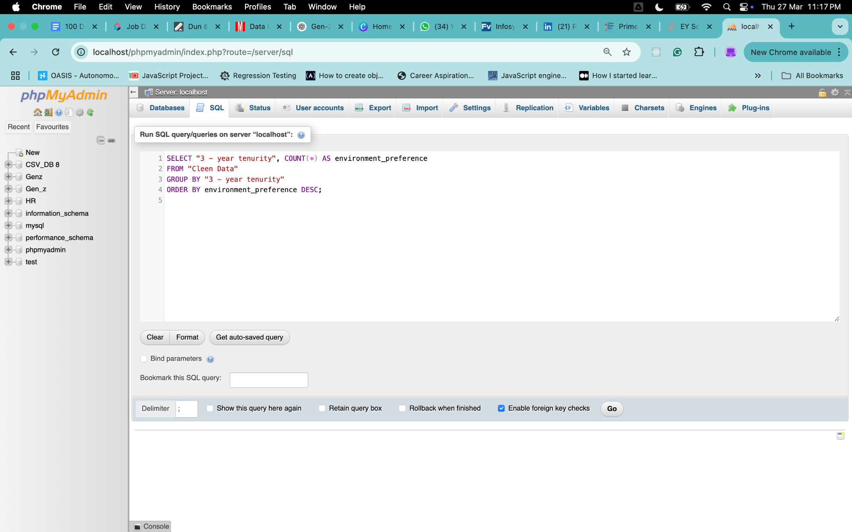
Cleaning and Standardizing in SQL
1. What industries are Gen-Z most interested in pursuing careers in?
4. How do financial goals, such as salary and benefits, impact career aspirations among Gen-Z?
2. What are the top factors influencing Gen-Z’s career choices?
5. What role do personal values and social impact play in career choices for Gen-Z?
3. What is the desired work environment for Gen-Z? (e.g., remote, hybrid, in-office)

Slide 8
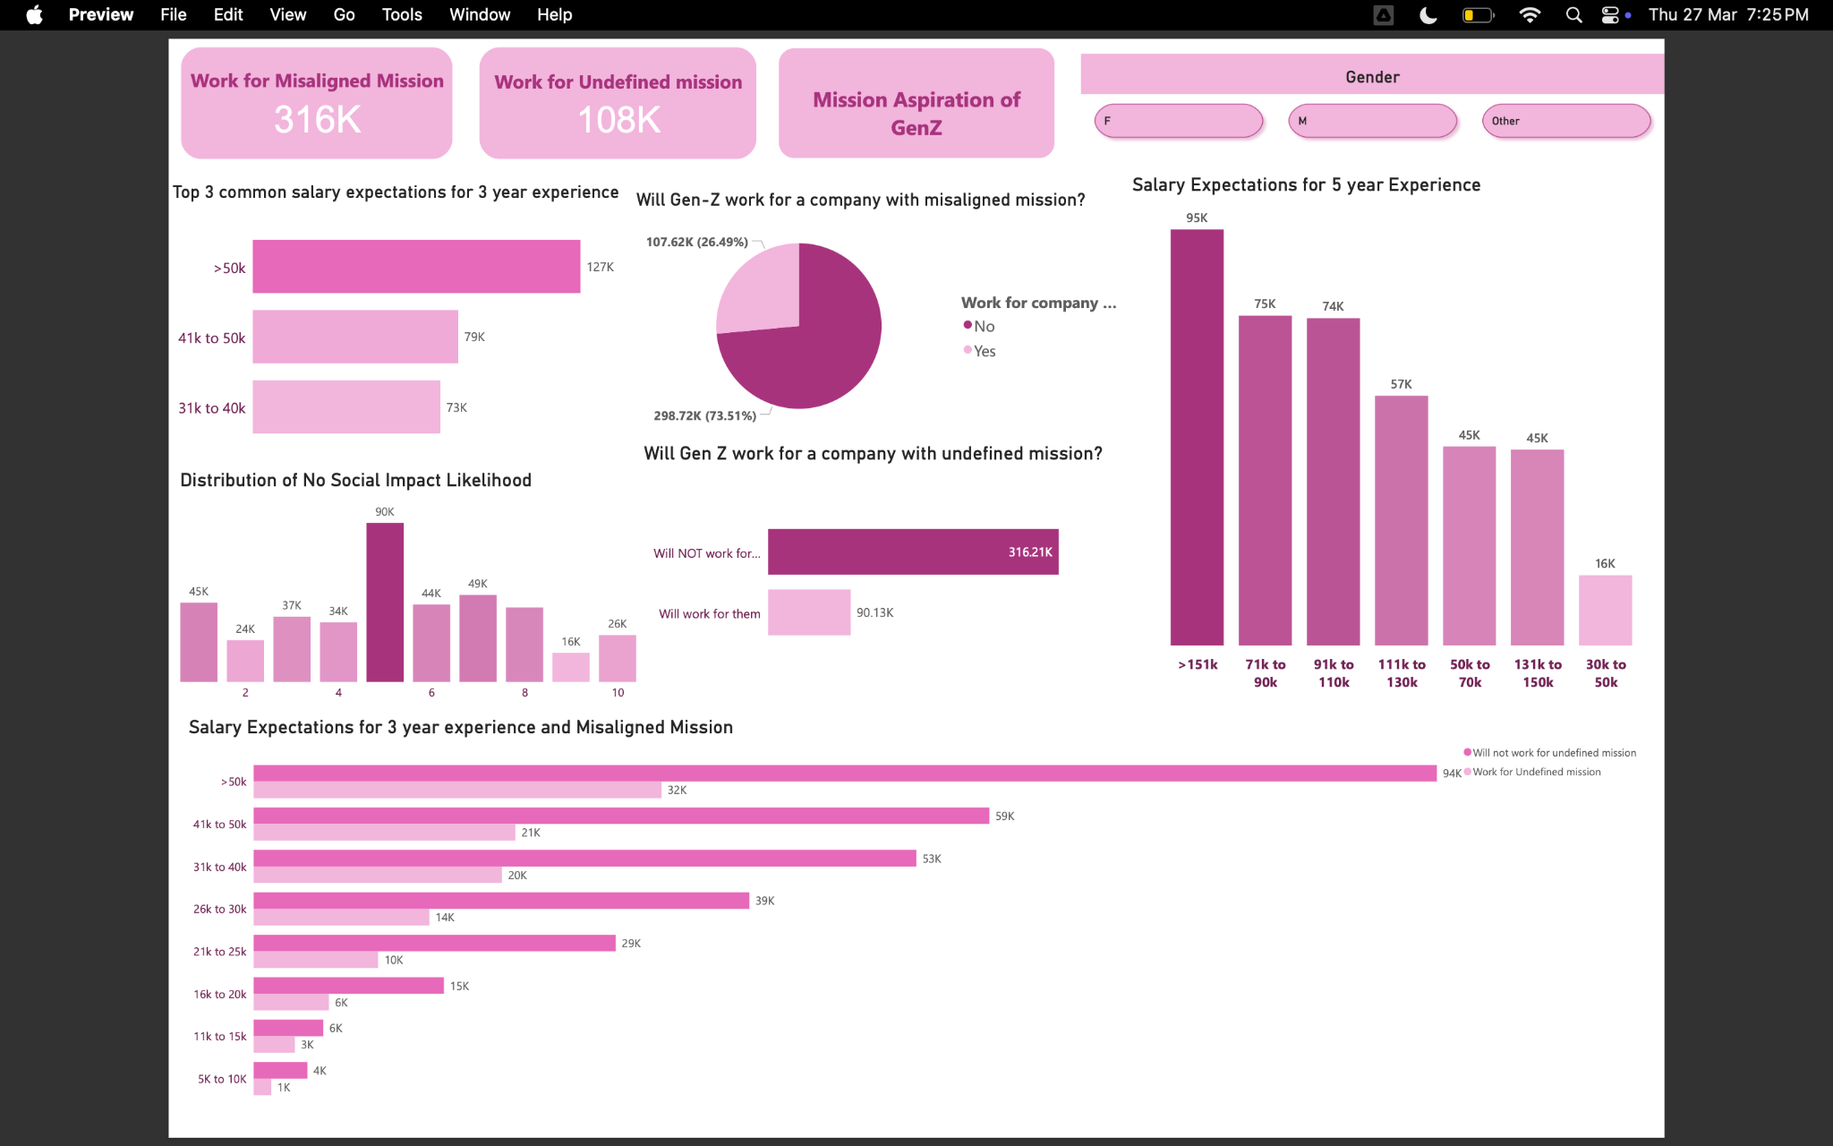
GENERAL POWER BI DASHBOARD

Slide 9
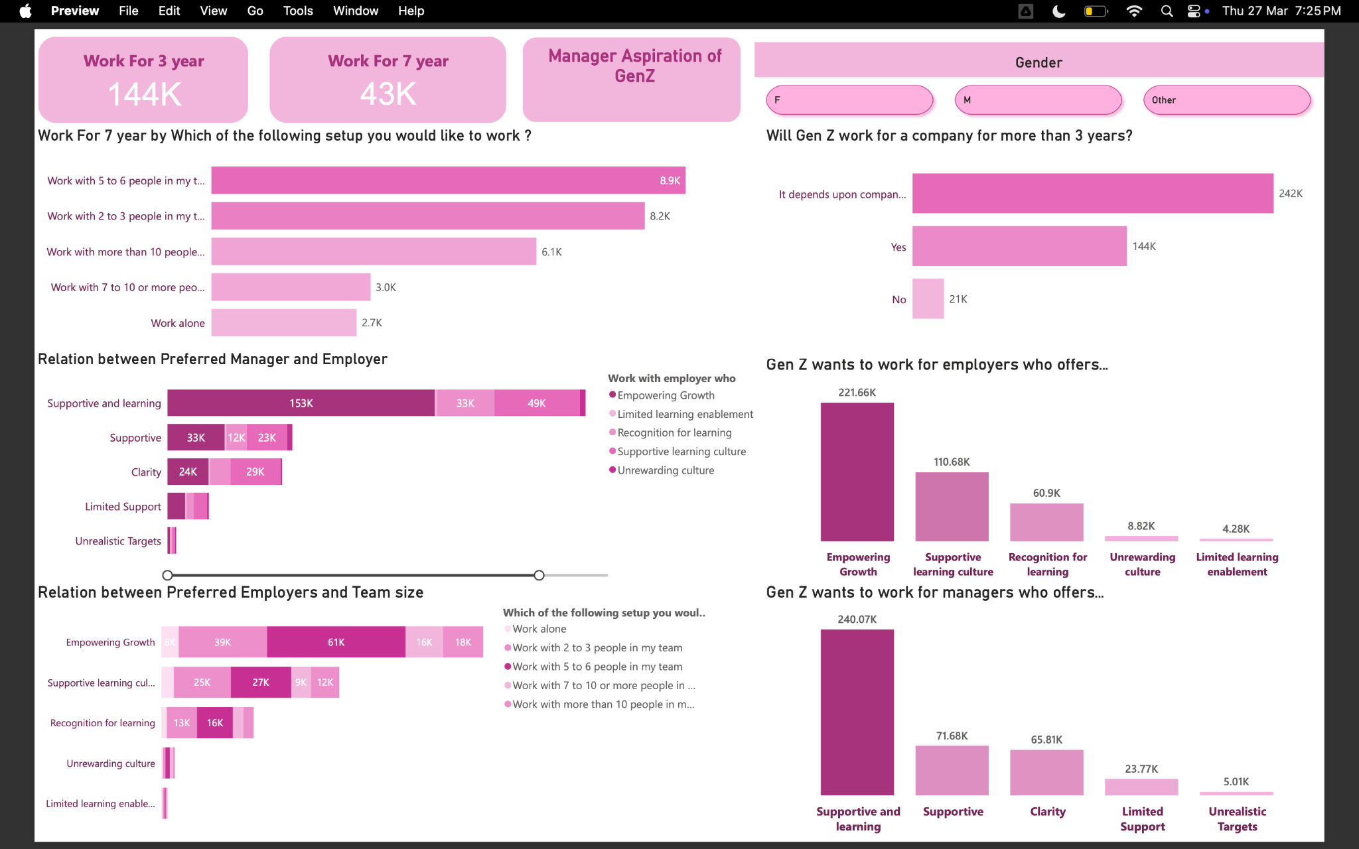

Slide 10
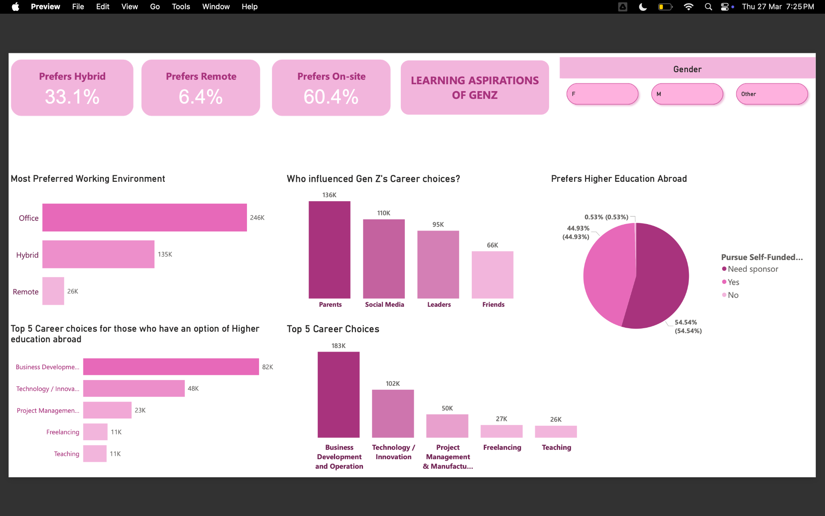

Slide 11
Findings and Insights
PROBLEM: Reluctance to Work for Companies with Misaligned or Undefined Mission
73.51% of Gen Z will not work for a company whose mission does not align with their values.
316K respondents stated they would work for a company with an misaligned mission.
RECOMMENDATIONS:
❑ Clearly define and communicate the company’s mission and values.
❑ Align business goals with social impact initiatives.
❑ Build a strong employer brand that resonates with Gen Z's expectations.
❑ Implement transparency in decision-making and corporate ethics.

Slide 12
Findings and Insights
PROBLEM: High Salary Expectations with Career Progression
Top salary expectations for 3 years of experience:
127K expect >50K salary
79K expect 41K–50K
73K expect 31K–40K
For 5 years of experience:
Most expect 71K–130K+
RECOMMENDATIONS:
❑ Offer competitive salary packages with clear progression paths.
❑ Provide performance-based incentives and bonuses.
❑ Implement mentorship programs to fast-track growth.
❑ Conduct market salary benchmarking to attract and retain talent.

Slide 13
Findings and Insights
PROBLEM: Career Longevity Concerns
242K Gen Z employees said staying for more than 3 years depends on the company.
Only 43K are willing to stay for 7+ years.
RECOMMENDATIONS: ❑ Introduce long-term career development plans. ❑ Provide continuous learning and upskilling opportunities. ❑ Improve workplace flexibility and work-life balance. ❑ Enhance company culture and employee engagement programs.

Slide 14
Findings and Insights
PROBLEM: Manager Expectations vs. Reality
240K Gen Z professionals prefer a supportive and learning-oriented manager.
Only 23K work under supportive managers, while 5K report unrealistic targets.
RECOMMENDATIONS: ❑ Train managers to adopt coaching and mentorship leadership styles. ❑ Implement 360-degree feedback mechanisms for manager evaluations. ❑ Encourage open communication between leadership and employees. ❑ Recognize and reward supportive management practices.

Slide 15
Findings and Insights
PROBLEM: Work Environment Preferences
60.4% prefer on-site work, while 33.1% prefer hybrid, and 6.4% prefer remote.
RECOMMENDATIONS: ❑ Offer hybrid work models to accommodate different preferences. ❑ Create engaging in-office experiences to retain employees. ❑ Provide remote work infrastructure for enhanced productivity.

Slide 16
Findings and Insights
PROBLEM: Gen Z's Career Choice Influences
136K influenced by parents, 110K by social media, 95K by leaders, and 66K by friends.
Top career aspirations: Business Development, Tech & Innovation, Project Management, Freelancing, Teaching.
RECOMMENDATIONS: ❑ Strengthen employer branding through social media outreach. ❑ Collaborate with industry leaders and influencers to attract talent. ❑ Offer mentorship and networking programs for career growth. ❑ Provide internship and apprenticeship opportunities for early exposure.

Slide 17
Thank You!!!

